Slide 1


ADEMOLA

Slide 2
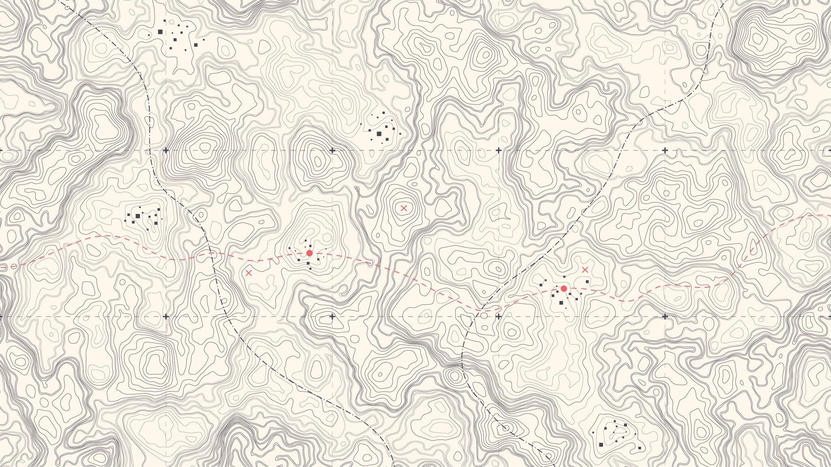

Mapping Fluoride Contamination Risk In Dockum Aquifer
Aalok Sharma Kafle
Ademola O Ibironke
Deseyi D John

Slide 3
Literature Review
F⁻ in GW can be because of natural or anthropogenic causes or a combination of both.¹
Weathering of rocks boosted by infiltration, Water soluble volcanic ash
Agricultural fertilizers, Coal combustion, Aerial Emission Deposits.
Desirable limit of fluoride (EPA) is 0.7 to 1.2 mg/L.²
High concentration causes various issues:
Acute to chronic dental fluorosis, skeletal fluorosis in humans.
Impact on soil fertility and plant and animal growth.²
Acidic soil allows for an increase of fluoride mobility and leaching.³
Brindha, K., & Elango, L. (2011). Fluoride in groundwater: causes, implications and mitigation measures. Fluoride properties, applications and environmental management, 1, 111-136.
Kut, K. M. K., Sarswat, A., Srivastava, A., Pittman Jr, C. U., & Mohan, D. (2016). A review of fluoride in African groundwater and local remediation methods. Groundwater for Sustainable Development, 2, 190-212.
Nelson, R., & Heo, J. (2020). Multiple Groundwater Parameters and Environmental Changes using Geospatial Techniques in the Permian Basin, Texas.
Notes:
https://www.sciencedirect.com/science/article/abs/pii/S2352801X16300339
where the tooth become colored (yellow/ brown).

Slide 4
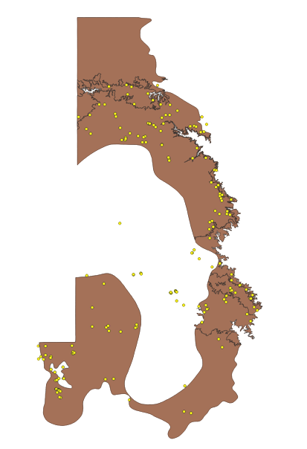
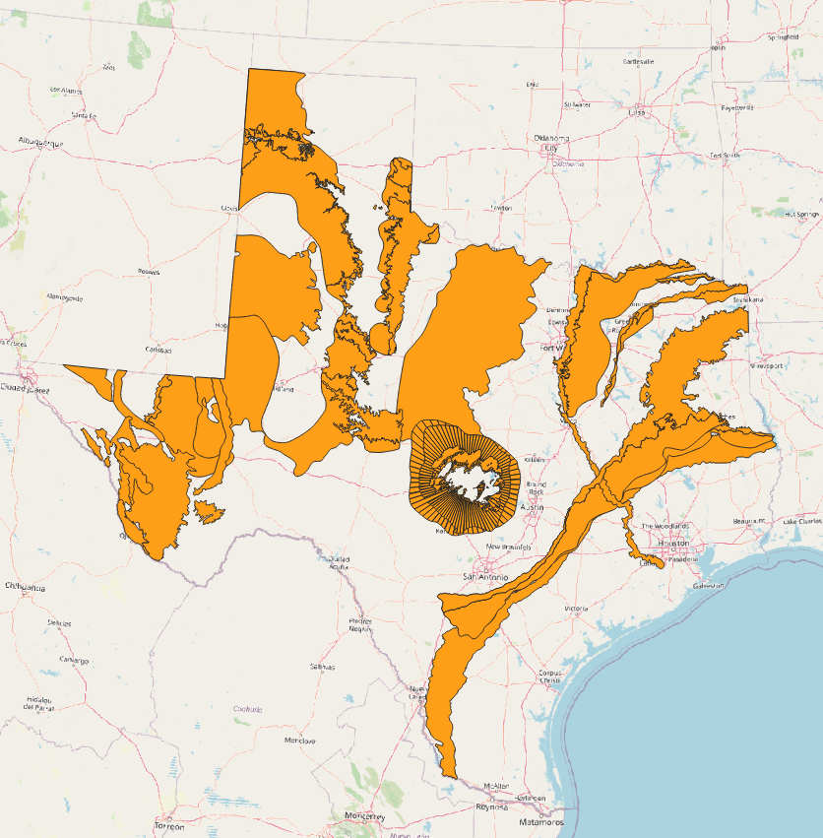
Study Area
(AQU_NAME='DOCKUM’)
Confined and Unconfined
Area of outcrop: 3,525 square miles
Area of subsurface: 22,030 square miles
Number of counties containing the aquifer: 46
Part of High Plains Aquifer System.
Mostly overlain by Ogallala Aquifer
Groundwater used for
Irrigation
Municipal Water Supply
Oil Field Waterproofing
Source: TWDB, Accessed 03/09/2023
https://www.twdb.texas.gov/groundwater/aquifer/minors/dockum.asp

Slide 5
Objective
To use Logistic regression (LR) and Naive Bayes Classifier (NBC) to develop and test Fluoride Exceedance Vulnerability model using actual data in Dockum Aquifer.
To use KNN with the predictions of LR and NBC to obtain a uniformly gridded dataset of F⁻vulnerability values covering the entire domain of the Dockum Aquifer.
Integrating the results from LR and NBC models to create a single final vulnerability map.

Slide 6
JOHN

Slide 7
Data Compilation / Filtering
Fluoride Concentration for Wells (Avg_Fl) from TWDB
Well Depth from TWDB
PRISM Data
30-yr Normal Precipitation : Annual (PPT)
30-yr Normal Mean Temperature : Annual (Tmean)
Landcover Data (MRLC Landcover)

Slide 8

SSURGO Data Extraction for Wells
Performed database queries by linking multiple tables together in SSURGO Database using Python (geopandas and fiona) and QGIS.
Extracted various parameters from chorizon, component chtexturegrp and chtexture table.

Slide 9
SSURGO data Extraction for Wells
Parameter | Description
slope | The difference in elevation between two points, expressed as a percentage of the distance between those points. (SSM)
elev | The vertical distance from mean sea level to a point on the earth's surface
sandtotal | Mineral particles 0.05mm to 2.0mm in equivalent diameter as a weight percentage of the less than 2 mm fraction
claytotal | Mineral particles less than 0.002mm in equivalent diameter as a weight percentage of the less than 2.0mm fraction
om | The amount by weight of decomposed plant and animal residue expressed as a weight percentage of the less than 2 mm soil material
ksat | The amount of water that would move vertically through a unit area of saturated soil in unit time under unit hydraulic gradient.
awc | The amount of water that an increment of soil depth, inclusive of fragments, can store that is available to plants
wsatiated | The estimated volumetric soil water content at or near zero bar tension, expressed as a percentage of the whole soil.
ll | The water content of the soil at the change between the liquid and plastic states
pi | The numerical difference between the liquid limit and plastic limit
kwfact | An erodibility factor which quantifies the susceptibility of soil particles to detachment and movement by water
kffact | An erodibility factor which quantifies the susceptibility of soil particles to detachment by water
ec | The electrical conductivity of an extract from saturated soil paste
ph | A numerical expression of the relative acidity or alkalinity of a soil sample
l | Low
r | Representative Value (Arithmetic Mean)
h | High

Slide 10
Recoding for Categorical Variables
Soil texture | Recode to
Loam | 1
Silty clay | 2
Clay loam | 3
Fine sandy loam | 4
Sandy clay loam | 5
Silty clay loam | 6
Loamy fine sand | 7
Silt loam | 8
Clay | 9
Fine sand | 10
Sandy loam | 11
Land use Code | Recoded to
52 | 1
21 | 2
82 | 3
71 | 4
22 | 5
23 | 6
24 | 7
31 | 8
Agricultural Indicator Variable (Ag_Ind)
1 for Planted / Cultivated Land
0 for all other classes

Slide 11
AALOK

Slide 12

Selection of Independent Variables
Domain Knowledge
Correlation between predictor variable and target variable.
Avoiding multicollinearity among the variables.
Feature Importance
Random Forest Regressor
Decision Tree Regressor

Slide 13
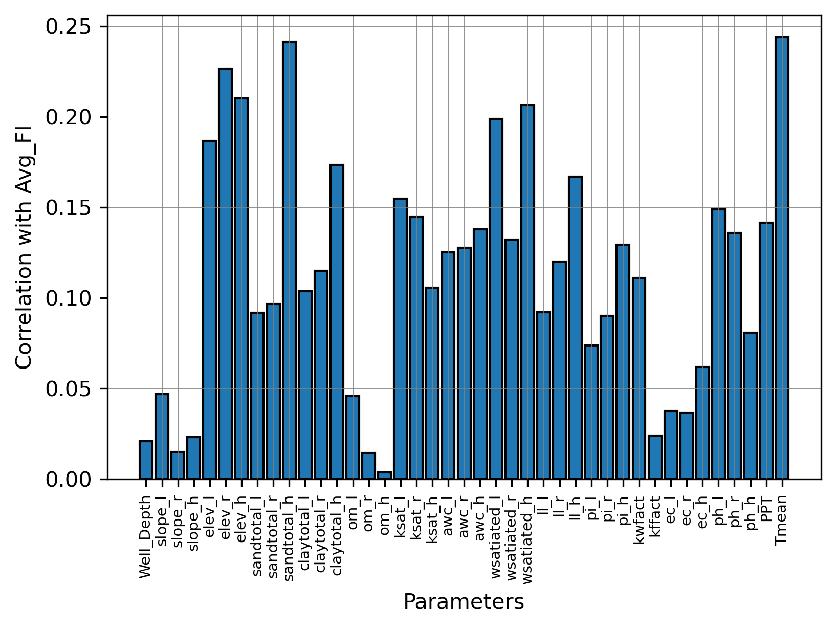
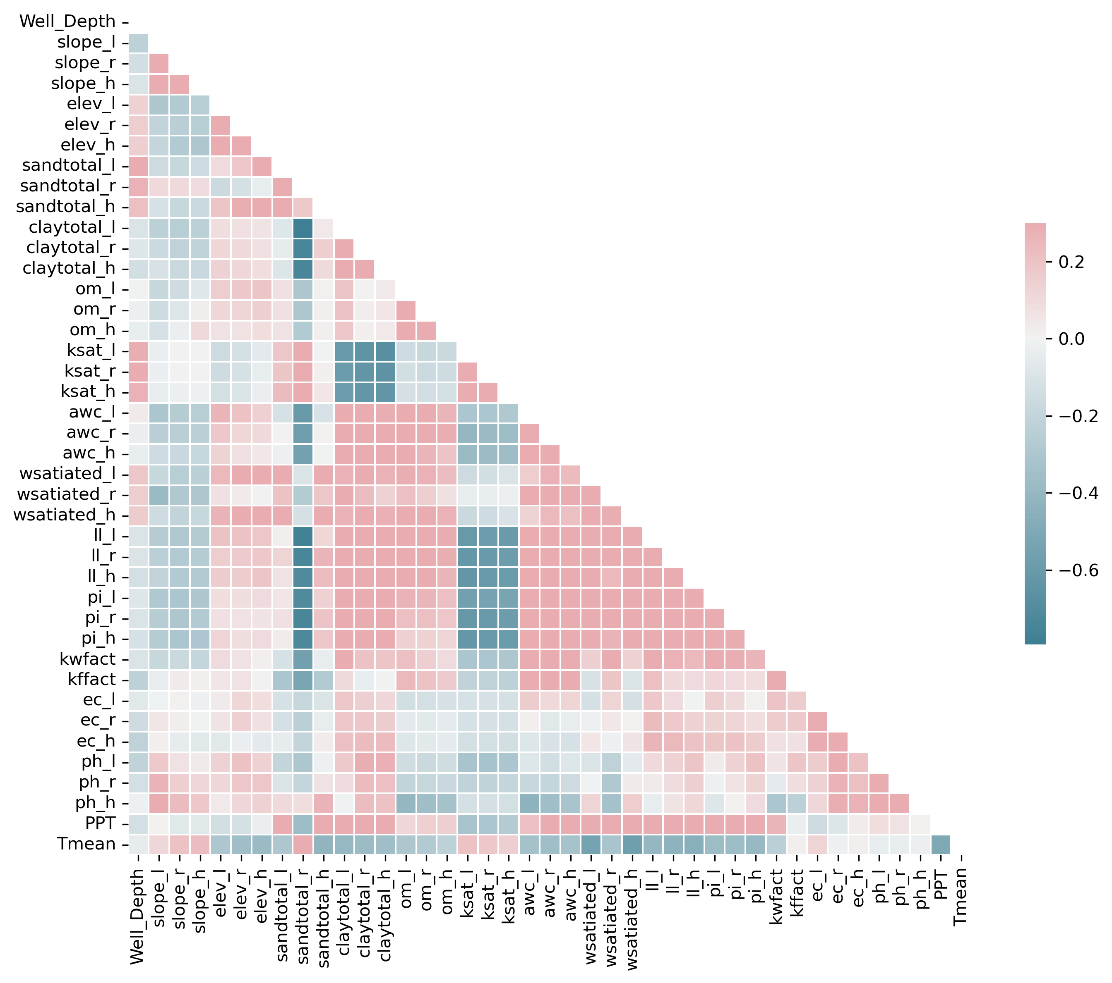
Correlation

Slide 14
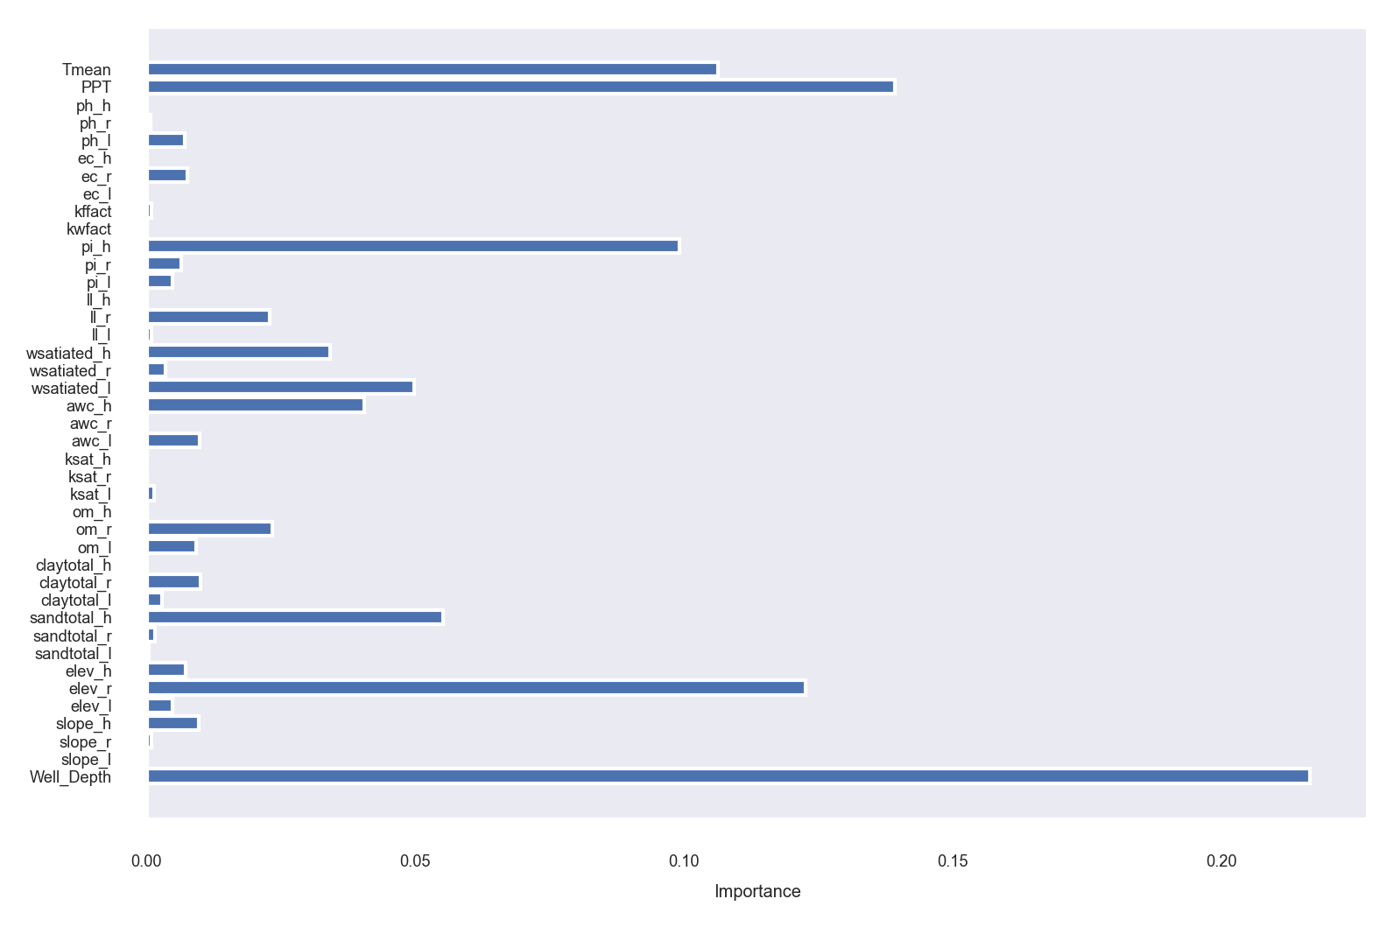
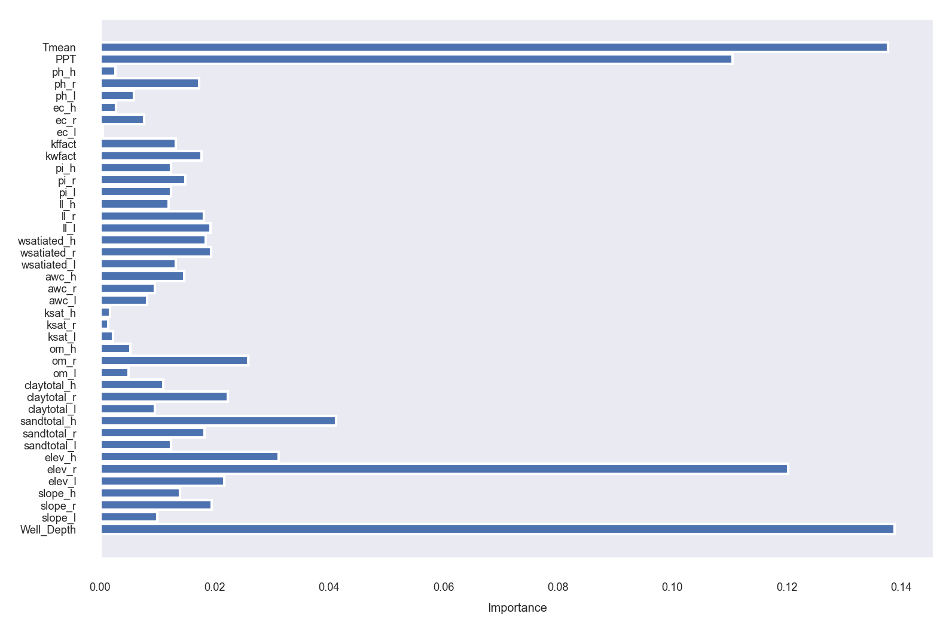
Feature Importance
Decision Tree Regressor
Random Forest Regressor

Slide 15
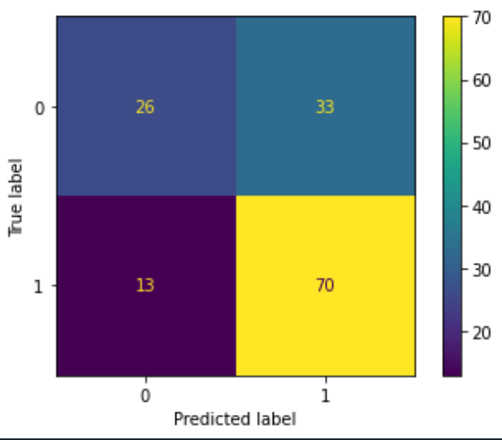
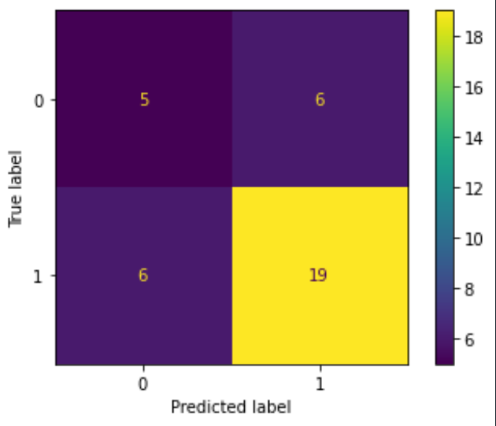
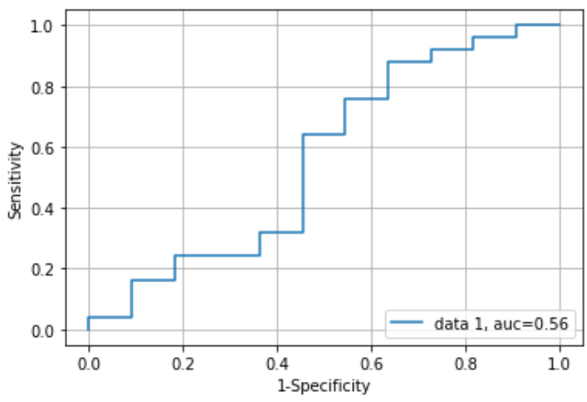
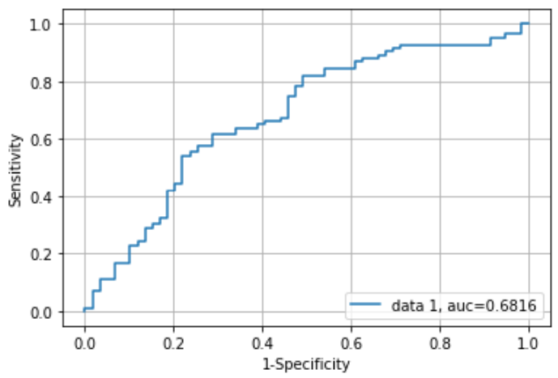
Logistic Regression Part of Ensemble 1
ppt
well_depth
sandtotal_h
claytotal_h
elev_r
om_l
ec_h
slope_r
ksat_h
ph_r
Kwfact
ph_r
Hyperparameter ‘C’ = 10**9
 | Train | Test
Accuracy | 0.676 | 0.667
Precision | 0.680 | 0.760
Recall | 0.843 | 0.760
F1 Score | 0.753 | 0.760
Notes:
However, larger values of C may be better when the data set is very small or the features are highly informative, as this can help the model fit the data more closely.

Slide 16
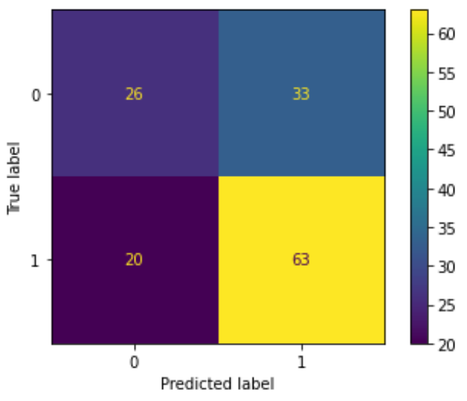
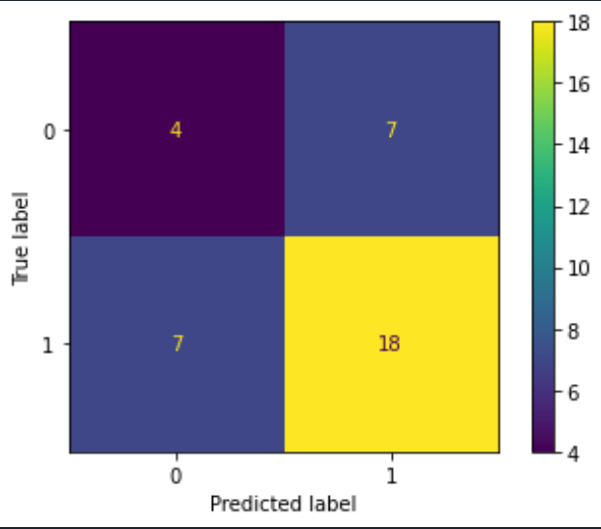
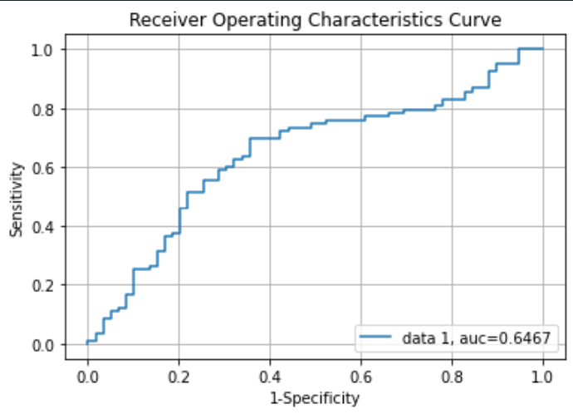
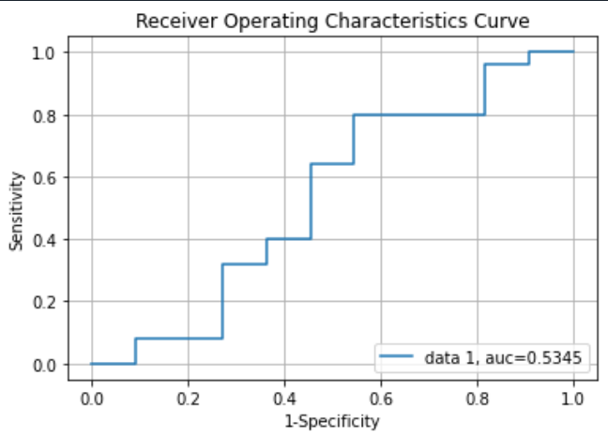
Naïve Bayes Classifier Part of Ensemble 1
 | Train | Test
Accuracy | 0.634 | 0.611
Precision | 0.674 | 0.720
Recall | 0.723 | 0.720
F1 Score | 0.700 | 0.720

Slide 17
Summary Measures
Measure | Equation | Training |  | Testing
 |  | LR | NBC | LR | NBC
True Positive | TP | 70 | 63 | 19 | 18
False Positive | FP | 33 | 33 | 6 | 7
False Negative | FN | 13 | 20 | 6 | 7
True negative | TN | 26 | 26 | 5 | 4
Prevalence | (TP + FN)/(TP+FP+FN+TN) | 0.5845 | 0.5845 | 0.6944 | 0.6944
Accuracy | (TP + TN)/(TP+FP+FN+TN) | 0.6761 | 0.6268 | 0.6667 | 0.6111
True Positive Rate | TP/(TP+FN) | 0.8434 | 0.7590 | 0.7600 | 0.7200
False Positive Rate | FP/(TN+FP) | 0.5593 | 0.5593 | 0.5455 | 0.6364
False Negative Rate | FN/(TP+FN) | 0.1566 | 0.2410 | 0.2400 | 0.2800
True Negative Rate | TN/(TN+FP) | 0.4407 | 0.4407 | 0.4545 | 0.3636
Positive Predictive Value | TP/(TP+FP) | 0.6796 | 0.6563 | 0.7600 | 0.7200
False Omission Rate | FN/(TN+FN) | 0.3333 | 0.4348 | 0.5455 | 0.6364
False Discovery Rate | FP/(TP+FP) | 0.3204 | 0.3438 | 0.2400 | 0.2800
Negative Predictive Value | TN/(TN+FN) | 2.0000 | 1.3000 | 0.8333 | 0.5714
Positive Likelihood Ratio | True Positive Rate/False Positive Rate | 1.5078 | 1.3571 | 1.3933 | 1.1314
Negative Likelihood Ratio | False Negative Rate/ True Negative Rate | 0.3554 | 0.5468 | 0.5280 | 0.7700
Diagnostic Odds Ratio | Positive Likelihood Ratio / Negative Likelihood Ratio | 4.2424 | 2.4818 | 2.6389 | 1.4694
Both LR And NBC have similar performance metrics

Slide 18
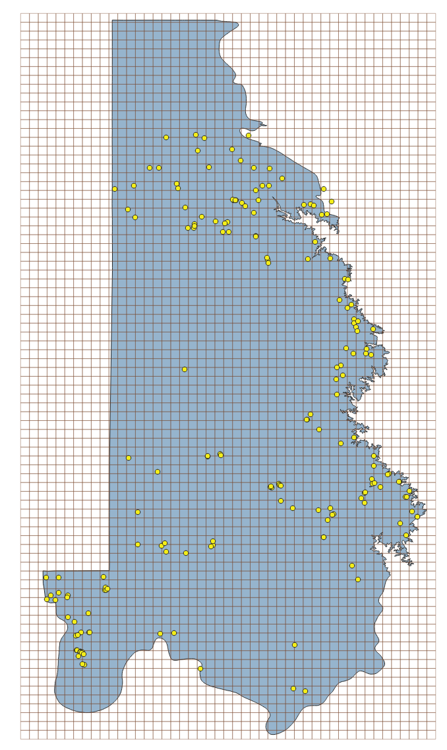
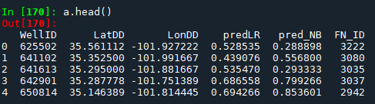
K-Nearest Neighbors Algorithm
Distance Metric : Haversine
Takes earth’s curvature into account while calculating distance.
Distance Metric : Haversine
Takes earth’s curvature into account while calculating distance.
When stations are in close proximity to each other, only one of those stations was randomly selected.
5-mile X 5-mile Fishnet was used to facilitate this random selection.
Removes location bias from clustering of wells on some areas.
The repeating station from the same fishnet used for testing KNN model.
$$Distance=2R_{earth}∗\text{arcsin}\text{(}\text{sqrt}\text{(}\text{sin}\text{²((}\text{lat}\text{₂ − }\text{lat}\text{₁)/2) + }\text{cos}\text{(}\text{lat}\text{₁) ∗ }\text{cos}\text{(}\text{lat}\text{₂) ∗ }\text{sin}\text{²((}\text{lon}\text{₂ − }\text{lon}\text{₁)/2)))}$$
def haversine(x1, x2):
"""
Calculate the Haversine distance between two points specified by
their latitude and longitude in decimal degrees.
"""
lat1, lon1 = x1[0], x1[1]
lat2, lon2 = x2[0], x2[1]
# convert decimal degrees to radians
lat1, lon1, lat2, lon2 = map(math.radians, [lat1, lon1, lat2, lon2])
# Haversine formula
dlon = lon2 - lon1
dlat = lat2 - lat1
a = math.sin(dlat/2)**2 + math.cos(lat1) * math.cos(lat2) * math.sin(dlon/2)**2
c = 2 * math.asin(math.sqrt(a))
r = 6371 # Radius of earth in kilometers. We can use 3956 for miles
return c * r
$$Distance=2R_{earth}∗\text{arcsin}\text{(}\text{sqrt}\text{(}\text{sin}\text{²((}\text{lat}\text{₂ − }\text{lat}\text{₁)/2) + }\text{cos}\text{(}\text{lat}\text{₁) ∗ }\text{cos}\text{(}\text{lat}\text{₂) ∗ }\text{sin}\text{²((}\text{lon}\text{₂ − }\text{lon}\text{₁)/2)))}$$
#Randomly sample one row from each group as training set
a_train = a.groupby('FN_ID').apply(lambda x: x.sample(1, random_state=42)).reset_index(drop=True)
# store the remaining rows in a testing set
a_test = a[~a.index.isin(a_train.index)]

Slide 19
KNeighborsRegressor Hyperparameters
KNeighborsRegressor from scikit-learn library.
n_neighbours : “5”
No. of nearest neighbors to consider when making predictions
weights: "distance"
Closer neighbors are given higher weight
algorithm: “auto”
Decide the most appropriate algorithm based on the values passed to fit method
metric: Self defined haversine function
Takes latitude and longitude to calculate distance between two point
Notes:
Choosing a larger value of n_neighbors will increase the bias of the model but decrease its variance, while choosing a smaller value of n_neighbors will increase the variance but decrease the bias.

Slide 20
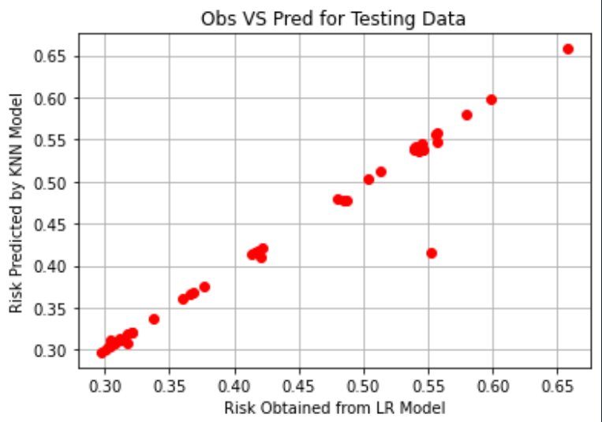
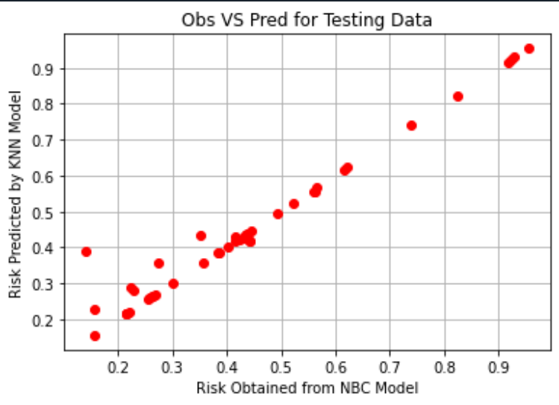
Fitting KNNs
knn = KNeighborsRegressor(n_neighbors=5, metric=haversine, weights= 'distance')
knn.fit(X_train, Y_train)
Using LR Predictions As Target Variable
Using NBC Predictions As Target Variable

Slide 21
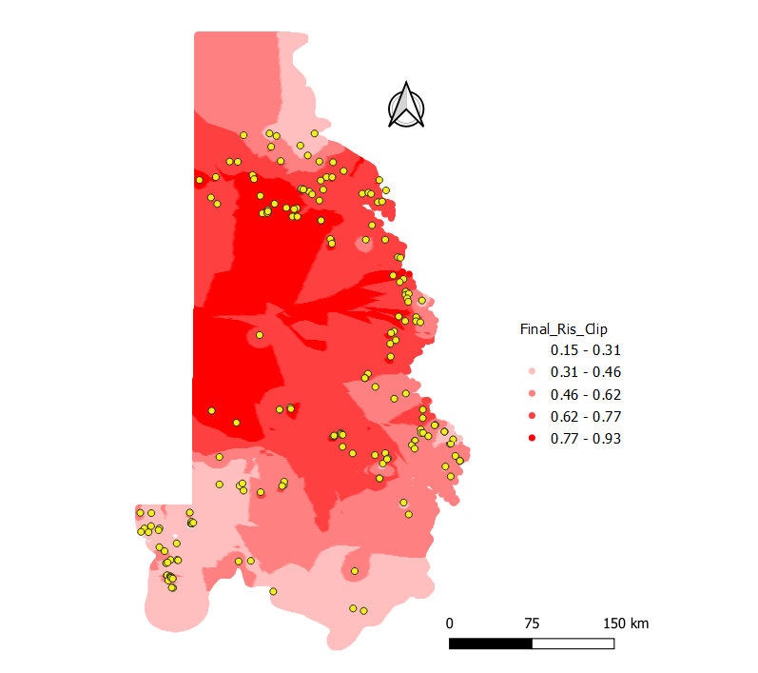

Creating Single Vulnerability Map
Both LR And NBC models have similar performance metrics.
Assumption: Errors from models are likely to be uncorrelated.
Model Averaging Ensemble
Smoothing out the errors and reducing the variance in the ensemble's predictions.
Exceedance Probability
(F⁻ > 1.5 mg/L)
Low
High
Notes:
The intuition behind this approach is that both models are likely to make some correct predictions and some incorrect predictions, but their errors are likely to be uncorrelated. By taking the average of their predictions, you are effectively smoothing out the errors and reducing the variance in the ensemble's predictions.

Slide 22
ADEMOLA

Slide 23
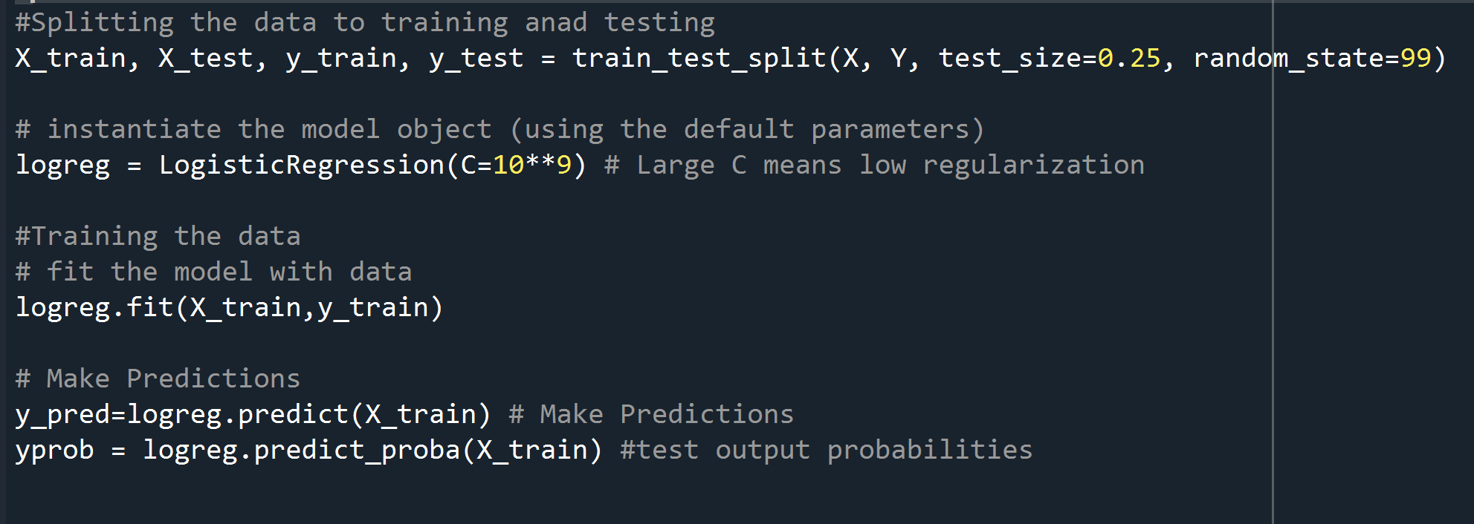
Logistic Regression Model
Supervised Learning Algorithm Used For Binary Classification Problems.
Models The Relationship Between A Binary Dependent Variable And One Or More Independent Variables.

Slide 24
Hyperparameters – LR Model
C - Value
Shows Regularization
Large C means weaker regularization, model is less constrained, algorithm can select more coefficients. Resulting more complex model with lower bias and higher variance.
Small C means stronger regularization, simpler model with higher bias and lower variance
In scikit-learn, the default value for C is 1.0
C values in the range of 10, 100, or 1000 can be considered large for many datasets.

Slide 25
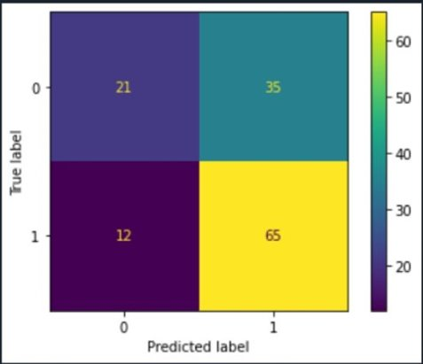
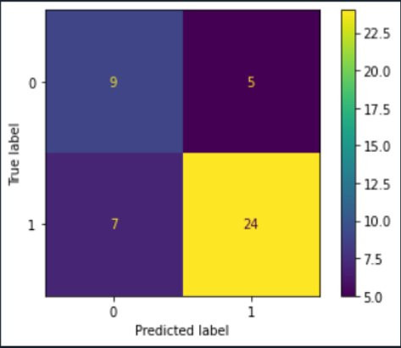
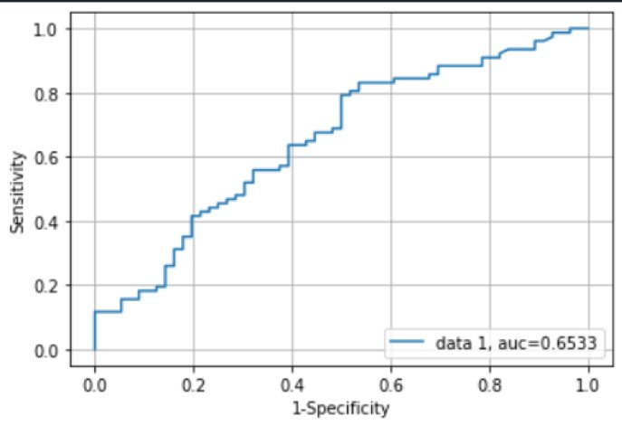
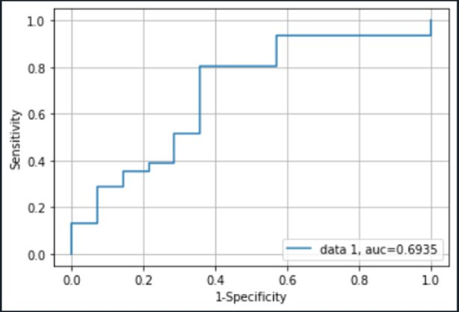
Logistic Regression Part of Ensemble 2
Electrical conductivity​​
Ph​​
Awc​​
Ppt​​
Wsatiated​​
Kffact
Slope​​
Elevation​​
Clay​
Organic matter​​
Ksat​
​ | Training​ | Testing​
Accuracy​ | 64.7%​ | 73.3%​
Precision​ | 65%​ | 82.7%​
Recall​ | 84.4%​ | 77.4%​
Notes:
However, larger values of C may be better when the data set is very small or the features are highly informative, as this can help the model fit the data more closely.

Slide 26
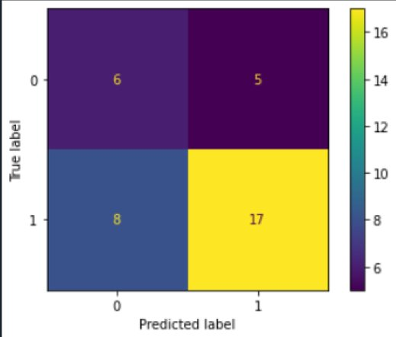
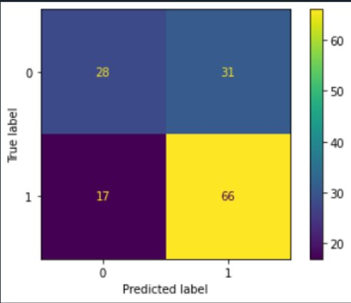
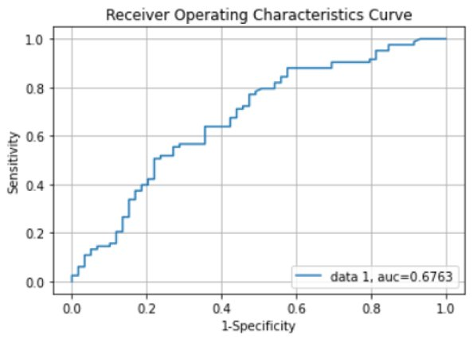
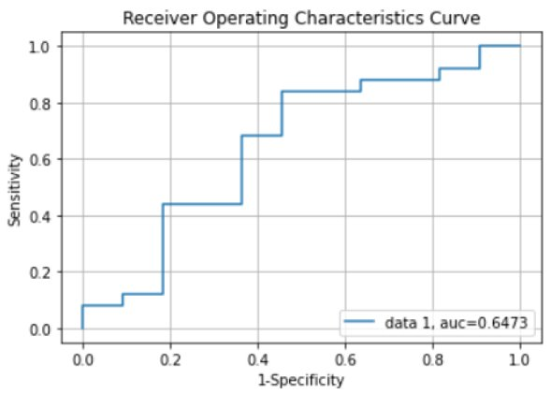
Naïve Bayes Classifier Part of Ensemble 2
​ | Training​ | Testing​
Accuracy​ | 64.7%​ | 73.3%​
Precision​ | 65%​ | 82.7%​
Recall​ | 84.4%​ | 77.4%​

Slide 27
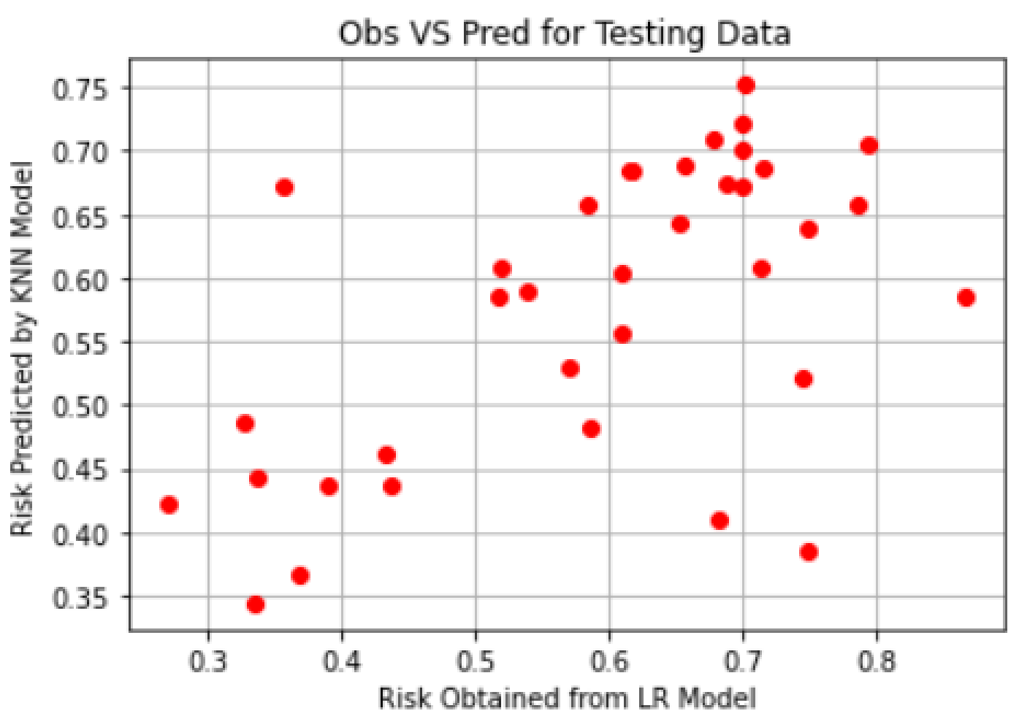
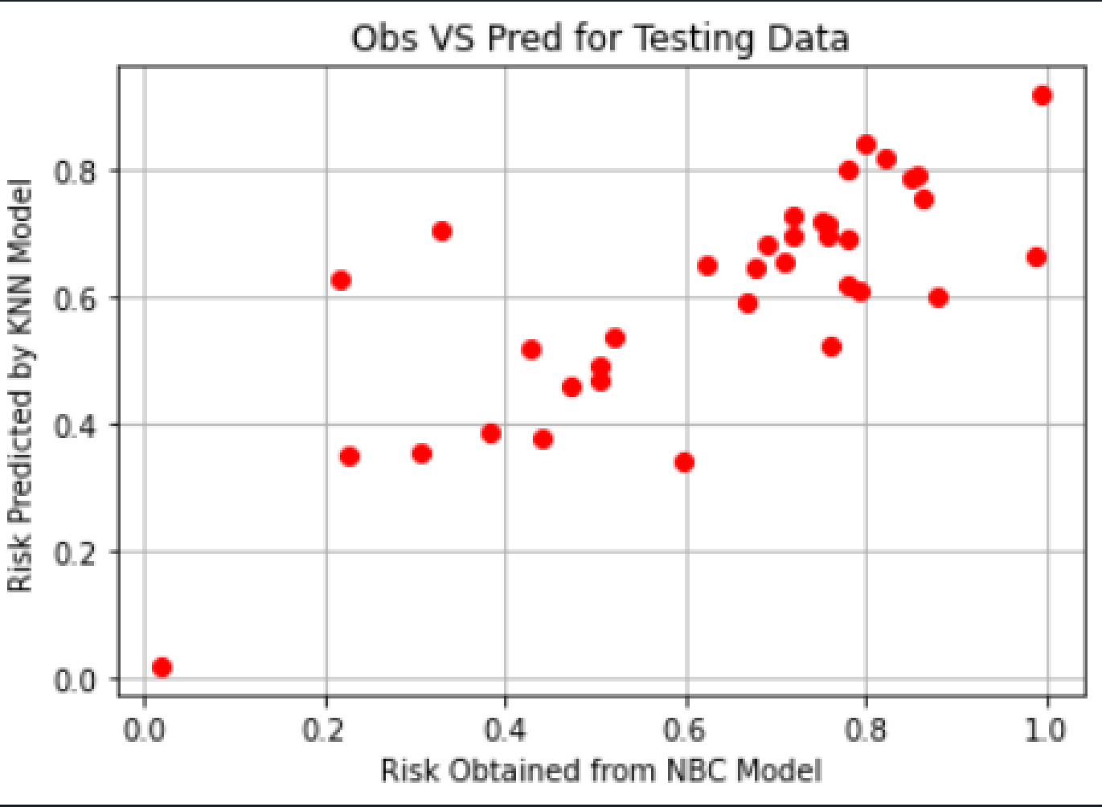
Fitting KNNs
Using LR Predictions As Target Variable
Using NBC Predictions As Target Variable

Slide 28
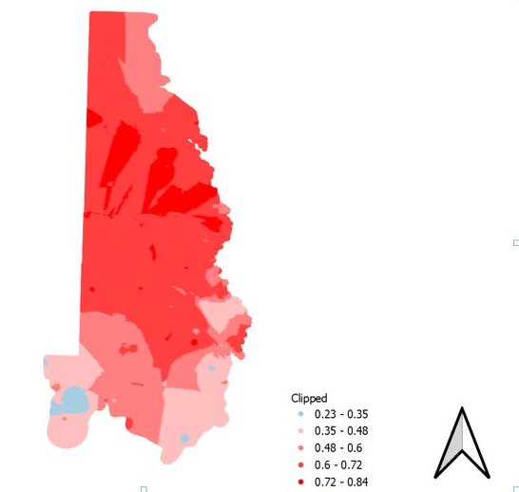
Vulnerability Map
Weighing each method
w1 = 0.7 Weightage for LR
w2 = 1 - w1 Weightage for NB

Slide 29
JOHN

Slide 30
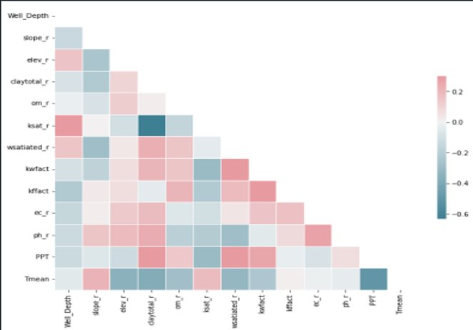
Parameter Selection
Parameters
Slope
Elevation
Clay
Orgarnic matter
Ksat
Wsatiated
Kwfact
Kffact​
Electrical Conductivity
PH
Precipitation
Temperature​

Slide 31
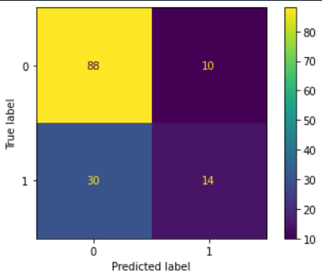
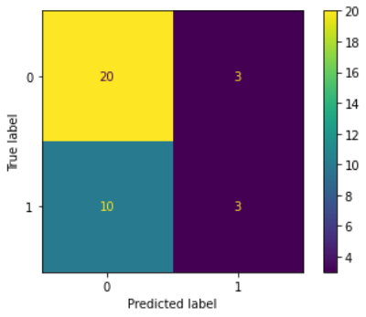
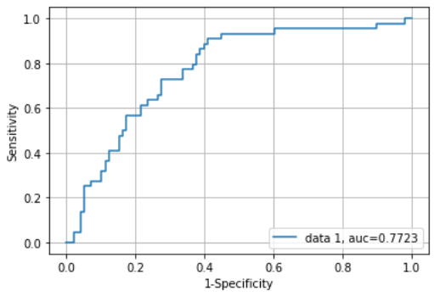
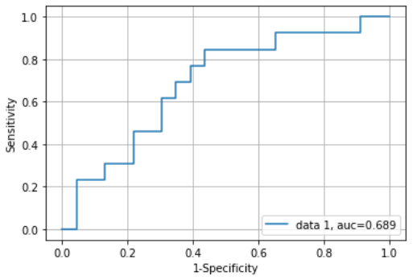
Logistic Regression Part of Ensemble 3
​ | Training​ | Testing​
Accuracy​ | 71.8% | 63.9%​
Precision​ | 58.3% | 58.2%
Recall​ | 31.8%​ | 31.6%​
Notes:
However, larger values of C may be better when the data set is very small or the features are highly informative, as this can help the model fit the data more closely.

Slide 32
Naïve Bayes Model
Machine Learning algorithm for classification tasks.
Works by estimating the probability of a given input belonging to a particular class based on the frequency of feature in the input.
Assumes that the features are independent of each other, which is why it’s called “Naïve”.
Despite this simplification, Naïve Bayes can be surprisingly effective in practice and has been successfully applied to a wide range of problem.
#Naive bayes model. note reconst is a categorical variable x[2] clf = gaussiannb() #create object clf.fit(x_train,y_train) # fit the model clf.predict(x_train) # predict training data
#Naive bayes model. note reconst is a categorical variable x[2] clf = gaussiannb() #create object clf.fit(x_test,y_test) # fit the model clf.predict(x_test) # predict training data

Slide 33
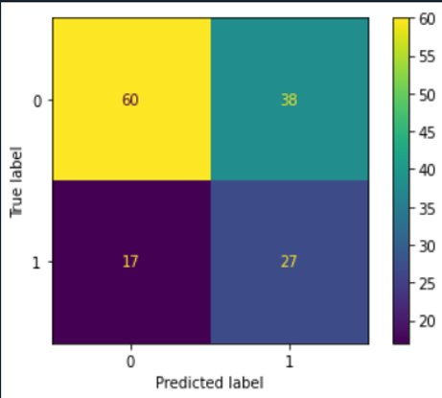
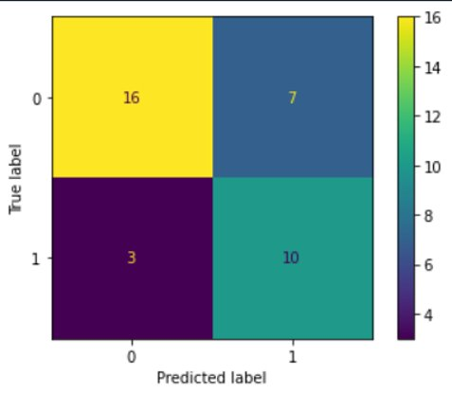
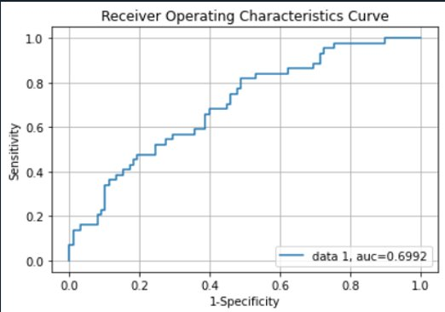
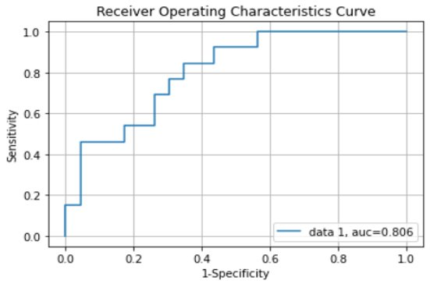
Naïve Bayes Classifier Part of Ensemble 2
​ | Training​ | Testing​
Accuracy​ | 61.3% | 73.2%​
Precision​ | 41.9% | 58.9%
Recall​ | 61.6%​ | 76.8%​

Slide 34
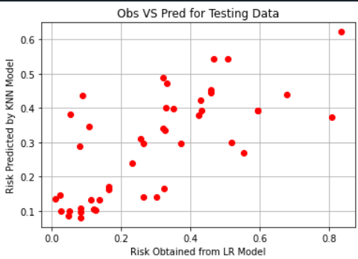
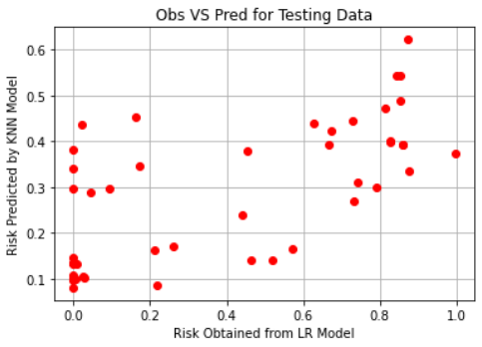
Fitting KNNs
Using LR Predictions As Target Variable
Using NBC Predictions As Target Variable

Slide 35
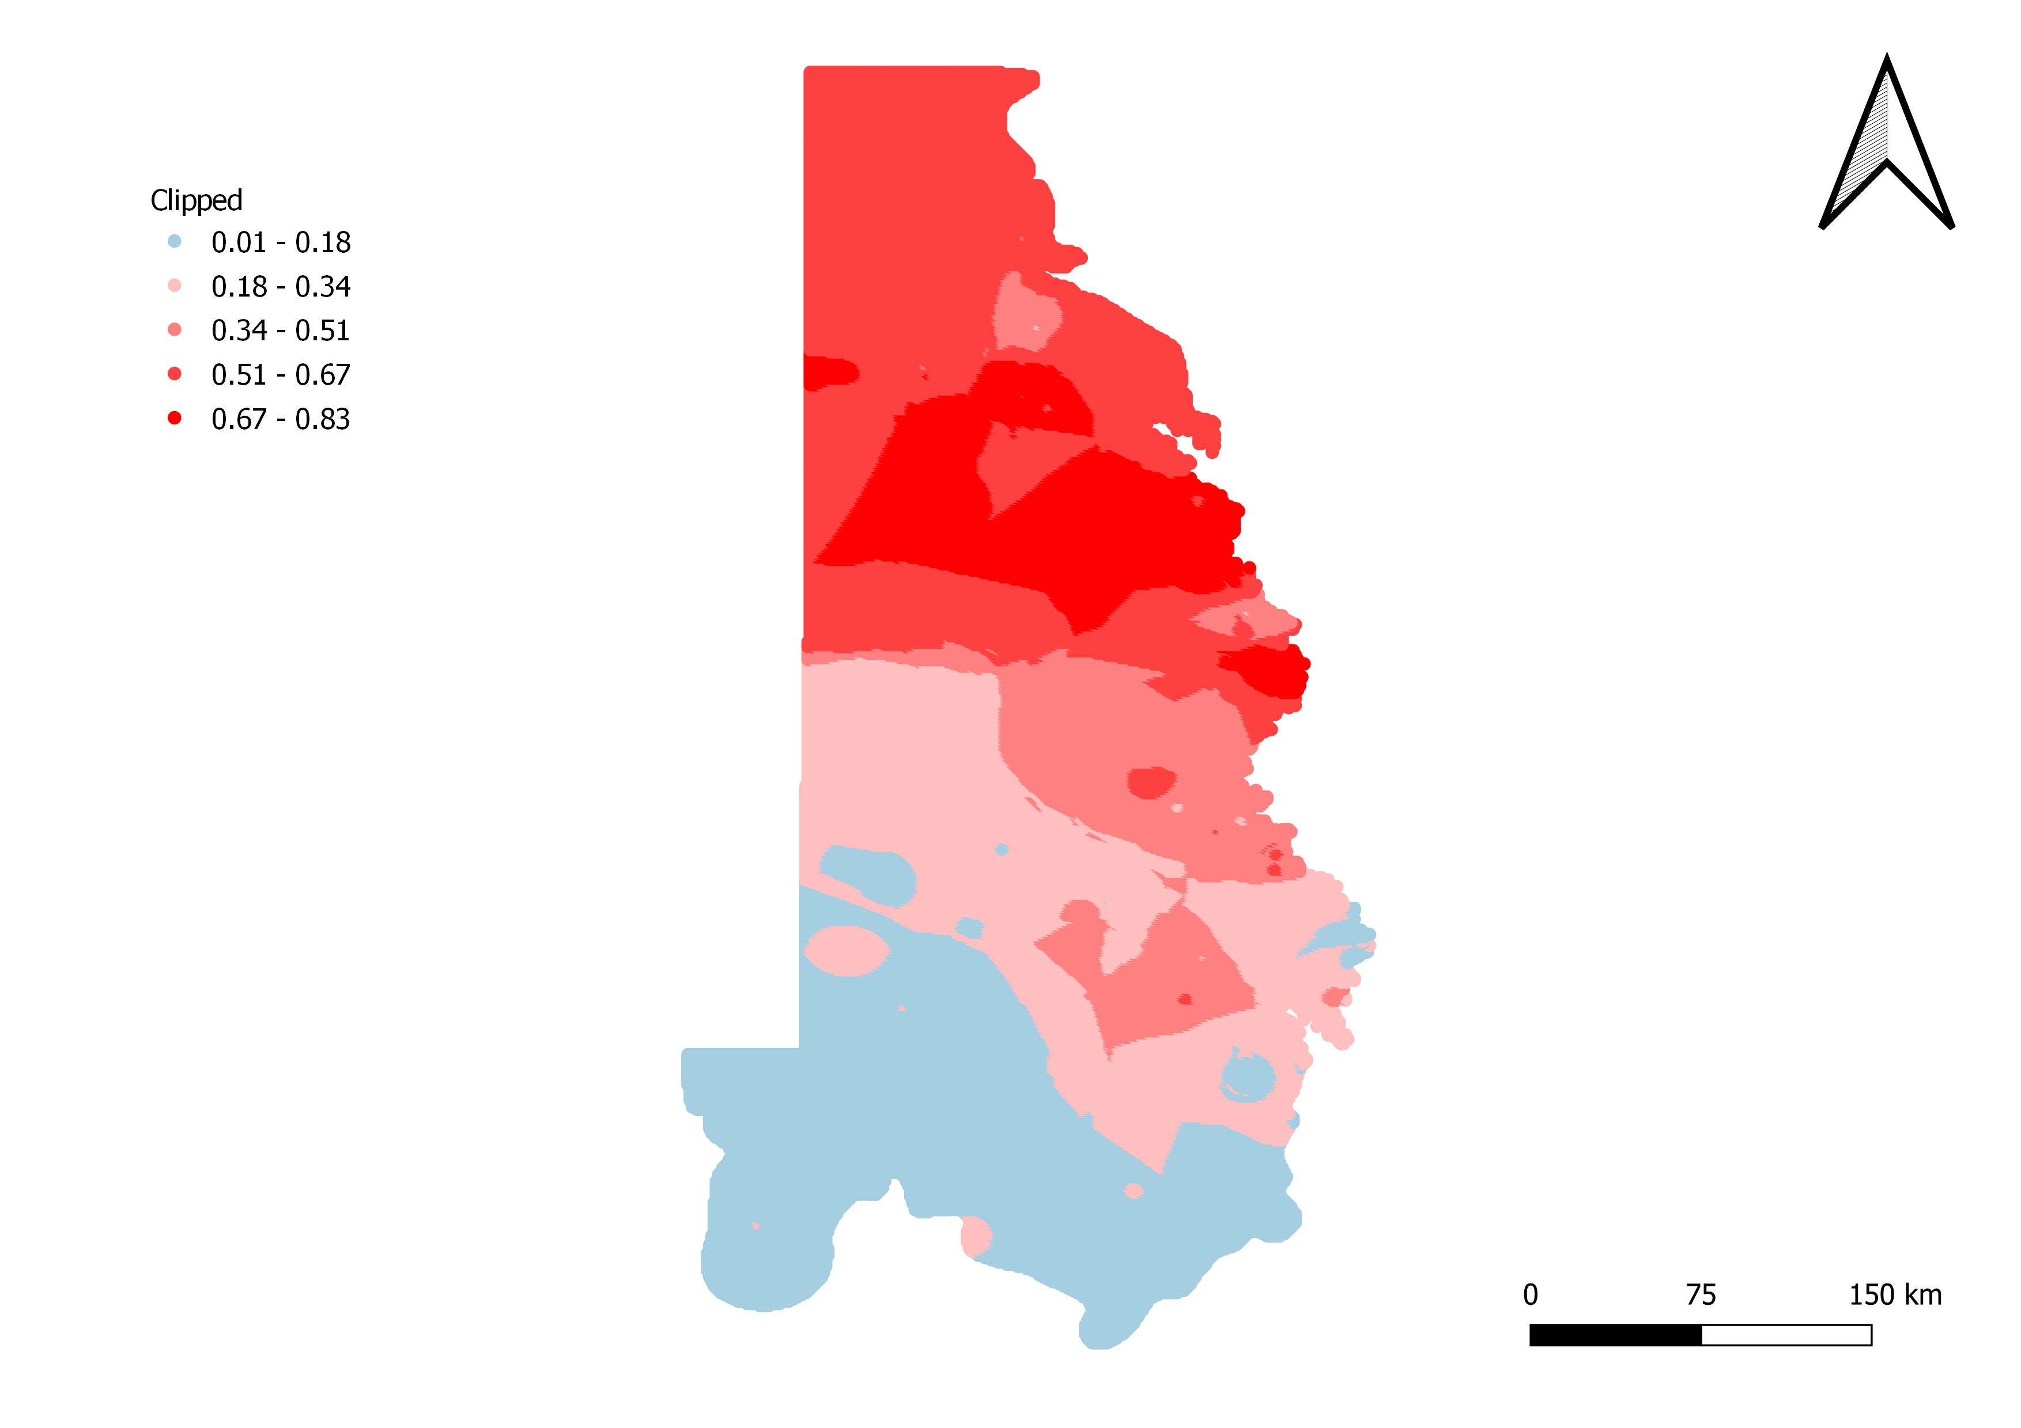
Vulnerability Map
Weighing each method
NB performed slightly better than LR and for this reason I chose to give the below weight to each methods
w1 = 0.45 Weightage for LR
w2 = 0.55 Weightage for NB

Slide 36
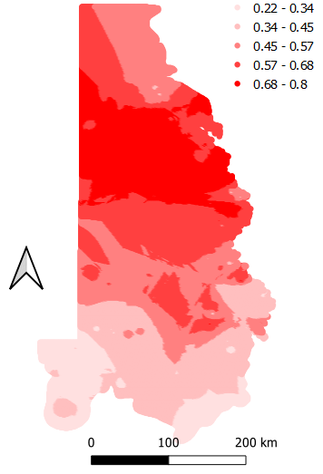
Conclusion
Fluoride vulnerability exceeding 1.5 mg/L were mapped based on the selected set of input parameters
North-eastern and Central portion of Dockum is more vulnerable to F⁻ contamination.
Map shows the final ensemble of all ensemble models with equal weightage.

